Slide 1

Virtualization

Slide 2
Virtualization
creation of a virtual (rather than actual) version of a server, a desktop, a storage device, an operating system or network resources.
a technique, which allows to share a single physical instance of a resource or an application among multiple customers and organizations.

Slide 3
Virtualization
Advantages:
Simultaneously run multiple virtual machines(VMs) on a physical machine
The VMs are logically isolated from each other and the underlying physical machine
Easy copying VMs from one host to another
Hardware resource redistribution between VMs.

Slide 4
How does virtualization work in cloud computing?
Normally in the cloud computing, users share the data present in the clouds like application etc, but actually with the help of virtualization users shares the Infrastructure.

Slide 5
Hypervisor
Also called VMM(Virtual Machine Manager)
The hypervisor manages shared the physical resources of the hardware between the guest operating systems and host operating system.
The main job of hypervisor is to control and monitoring the processor, memory and other hardware resources.

Slide 6
Hypervisor
Type 1
Type 2

Slide 7
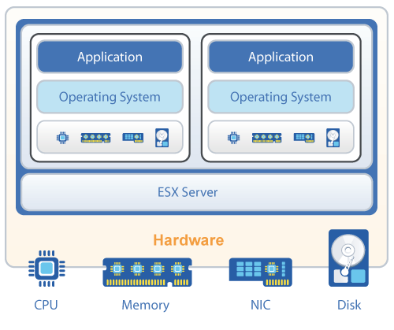
Type 1 Hypervisor

Slide 8
Type 1 Hypervisor
called a bare metal/native/embedded hypervisor.
This means that it runs directly on the physical hardware of the host machine
it doesn’t have to load an underlying Operating System before that
Type 1 hypervisors have direct access to the underlying hardware

Slide 9
Type 1 Hypervisor
Example:
1. VMware ESXi
2. Microsoft Hyper-V
3. Citrix/Xen Server

Slide 10
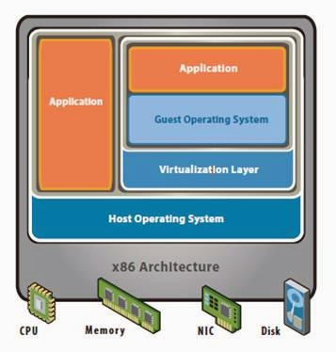
Type 2 Hypervisor

Slide 11
Type 2 Hypervisor
typically installed on an existing Operating System.
known as Hosted Hypervisor
completely dependent on host Operating System
convenient for users who want to run a VM on their PCs

Slide 12
Type 2 Hypervisor
Examples:
VMware Workstation
Oracle Virtual Box
Microsoft Virtual PC

Slide 13
Full virtualization | Para virtualization
In this, the guest OS is fully isolated using the virtual machine from the virtualization layer and hardware. | Here, the guest OS isn't isolated fully, but is partially isolated from the virtualization layer and hardware with the help of the virtual machine.
Full virtualization allows guest operating systems to execute independently | Para virtualization allows guest operating systems to communicate with the hypervisor.
guest operating system issues hardware calls to access hardware | guest operating system directly communicates with the hypervisor using drivers.
Performance is less | This technique aims to improve the VM’s performance by modifying the guest OS.

Slide 14
Virtualization
Conclusion:
Mainly Virtualization means, running multiple operating systems on a single machine but sharing all the hardware resources.
It helps us to provide the pool of IT resources so that we can share these IT resources in order get benefits in the business.

Slide 15
Thank You

